Slide 1
Human Voice Sentiment Identification
Short Story Assignment - CMPE 255
Harika Nalam
SJSU ID - 015939963

Slide 2
Introduction about topic
Sentiments play a vital role in human beings, used to find the mindset of human beings also known as speech emotion recognition.
Developments in the field of voice recognition -
Amazon Alexa
Google home
Apple homepod
The main purpose of sentiment identification is the enhancement of man-machine communication

Slide 3
Steps Followed
Data collection
Data preprocessing
Feature Extraction
Dimensionality Reduction
Training and Testing Model
Results

Slide 4
About Dataset used:
Berlin emotional speech database is used in the paper.
Dataset consists of toal 311 samples of 10 actors voice. (5 Male and 5 Female)
70 sad samples
66 happy samples
65 fear samples
110 anger samples

Slide 5
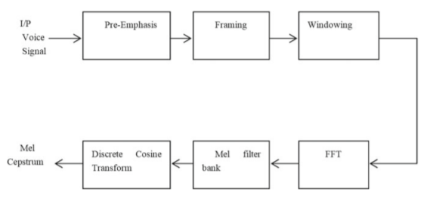
Preprocessing

Slide 6
Feature Extraction
Important features extracted from audio signals
Pitch
Bandwidth
Energy
Frequency
MFCC

Slide 7
Dimensionality Reduction using PCA
Input is n*m feature matrix X and the output is n*k feature matrix (k<m)

Slide 8
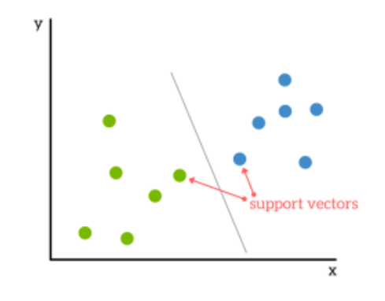
Support Vector machine
Multiclass SVM classifier is used as dataset is divided into four different classes.

Slide 9
Results
The overall accuracy of model is 84.99%

